Slide 1
MSSP 608: Practical Machine Learning Methods Week 3
1

Slide 2
READINGS
https://towardsdatascience.com/train-test-split-and-cross-validation-in-python-80b61beca4b6
***PLEASE READ BEFORE CLASS***

Slide 3
Review
3

Slide 4
Why Decision Trees?
Why choose decision tree over the multitude of other algorithms?
Decision trees are very efficient and can model very complex scenarios
They are fast to produce results
Biggest of all, they are the most interpretable algorithm in AI
The decision tree’s results can be easily understood

Slide 5
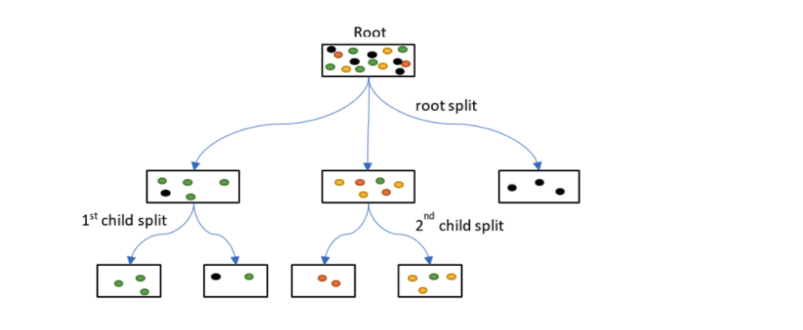
What is the goal of a decision tree?
Goal is to reduce chaos – the “root” node is very chaotic – i.e., many different colors
How do we reduce chaos?
Create groups that are “pure” (composed of one color)
Groups with 2 or more colors are considered “impure”
Is this possible?
Not likely, but we are working towards this goal
Balance between creating “pure” groups vs. “overfitting”

Slide 6
How does the algorithm decide which feature to place in each node?
Three measures
Entropy; information gain; Gini index
Entropy (also referred to as class entropy)
“Measures chaos” – chase
Goal of algorithm is to decrease entropy (i.e., “decrease chaos”)
Information Gain
Measures the reduction of entropy if we add a feature as the condition in each node at a particular depth
Goal of algorithm is to increase information gain (i.e., decrease entropy)
Gini Index
Impurity measure

Slide 7
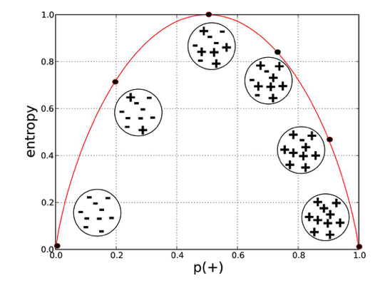
How does the algorithm decide which feature to place in each node?
Entropy (ranges from 0 to 1)
We want entropy to be close to 0, why?
Gini Index (ranges from 0 to 0.5)
We want information smallest value (i.e., less impure)
Information Gain (highest value – i.e., more information gained)

Slide 8
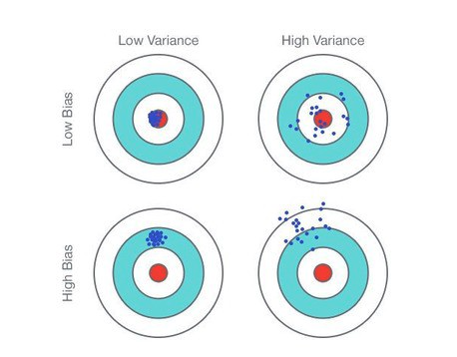
Bias and Variance
Variance – how spread apart?
Bias – how close to the target?

Slide 9
Bias and Variance in ML
Bias is the simplifying assumptions made by a model to make the target function easier to learn.
Low Bias: Fewer assumptions about the form of the Target Function
Decision Trees, k-Nearest Neighbors and Support Vector Machines
High Bias: More assumptions about the form of the target functions
Linear Regression, Linear Discriminant Analysis, and Logistic Regression.
Variance is the amount that the estimate of the target function will change if different training data was used.
Low Variance: Small changes to the estimate of the target function with changes to the training dataset
Linear Regression, Linear Discriminant Analysis, and Logistic Regression.
High Variance: Large changes to the estimate of the target function with changes to the training dataset
Decision Trees, k-Nearest Neighbors and Support Vector Machines

Slide 10
Research Example
10

Slide 11
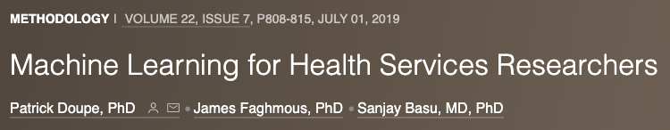
Background
Machine learning is increasingly used to predict healthcare outcomes, including cost, utilization, and quality.
Objective
We provide a high-level overview of machine learning for healthcare outcomes researchers and decision makers.
Methods
We then compare 3 of the most common machine learning methods:
(1) decision tree methods that can be useful for identifying how different subpopulations experience different risks for an outcome

Slide 12
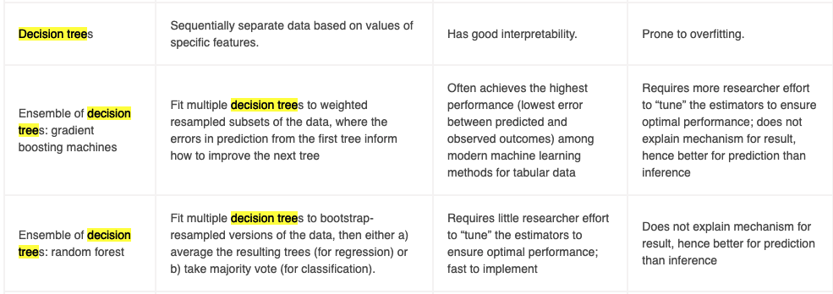
Decision trees …
Decision trees are familiar tools used for medical decision making and resemble a flowchart that guides a reader toward classifying a person as either higher risk or lower risk for an outcome
A good decision tree will separate the sampled population into groups that have low within-group variability but high between-group variability in the probability of the outcome.
The advantage of a decision tree is the ability to consider nonlinear relationships among multiple covariates that define subgroups in a data-driven way

Slide 13
Decision trees in health care …
Most helpful for research questions that involve predicting how the risk of an outcome differs among subpopulations or when considering multiple (and potentially multilevel) complex influences on the risk of a health outcome that may be hard to predict through standard logistic regression.
For example, people who have the highest risk for a hospitalization for diabetes complications may have a combination of high diabetes medication copays, low income, a long distance to a pharmacy, and may be in an age group that is older but not old enough to qualify for Medicare.
Trees can help decipher such complex dependencies.
Trees can also be more useful than standard logistic regression when researchers are trying to predict a rare outcome (such as a very high-cost hospitalization) caused by a constellation of complex interacting factors.
A limitation of decision trees is that they are prone to overfitting, such that a subgroup may be identified because the decision tree has overinterpreted noise in the data, and even cross-validation may not detect the overfitting.

Slide 14
Objectives
Train / test data
Overfitting vs. underfitting
Model quality metrics
Model comparison

Slide 15
Train / test data
15

Slide 16
Overfitting vs. underfitting
In ML, we split our data into two subsets
Training data and testing data
What happens if we do not do that?
Overfit the model
Underfit the model
Both affect the predictability of our model
i.e., our model has lower accuracy and/or cannot be generalized to other data
https://www.youtube.com/watch?v=MDiZg88mg9c

Slide 17
Overfitting
Model we trained has trained “too well” and fits too closely to the training data
This happens with complex models (i.e., too many features/variables compared to the number of observations).
Very accurate on the training data but not accurate on untrained or new data
Not generalized (or not AS generalized), meaning you can generalize the results and can’t make any inferences on other data, which is, ultimately, what you are trying to do.
The model learns or describes the “noise” in the training data instead of the actual relationships between variables
https://www.youtube.com/watch?v=DEMmkFC6IGM

Slide 18
Underfitting
Model does not fit the training data and misses the trends in the data
It also means the model cannot be generalized to new data
Due to a very simple model (not enough predictors)
For example, this occurs when we fit a linear model (like linear regression) to data that is not linear
It almost goes without saying that this model will have poor predictive ability on training data
i.e., cannot be generalized to other data)
https://www.youtube.com/watch?v=0h8lAm5Ki5g

Slide 19
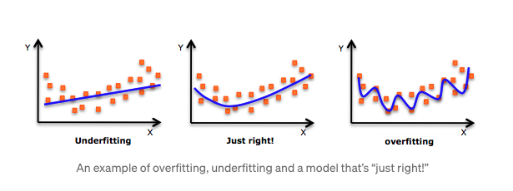
https://www.youtube.com/watch?v=Anq4PgdASsc

Slide 20
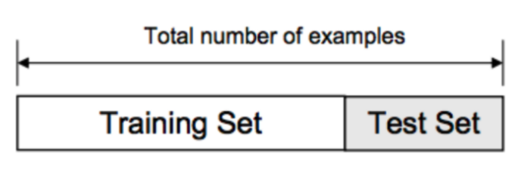
Training/Test Split
The training set contains a known output, and the model learns on this data in order to be generalized to other data later
We have the test dataset (or subset) in order to test our model’s prediction on this subset
https://www.youtube.com/watch?v=Zi-0rlM4RDs&t=358s

Slide 21
Training/Test Split Steps…
Load data
Split it into a training and testing sets
Fitted a regression model to the training data
Make predictions based on this data and tested the predictions on the test data

Slide 22
Dangers of Train/Test Split…
What if the split we make isn’t random?
What if one subset of our data has only people from a certain state, employees with a certain income level but not other income levels, only women or only people at a certain age?
This will result in overfitting, even though we’re trying to avoid it!
This is where cross validation comes in (later in semester…)

Slide 23
Metrics of Model Quality
23

Slide 24

Accuracy
While accuracy is great some of the time, there are many cases where it is not a good metric for understanding the performance of our models

Slide 25
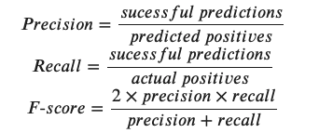
Precision, Recall, and F-score
https://www.youtube.com/watch?v=Dr7lbdgzpWM

Slide 26
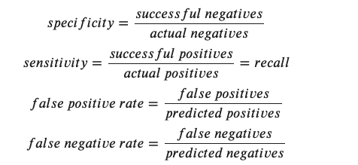
Additional metric calculation

Slide 27
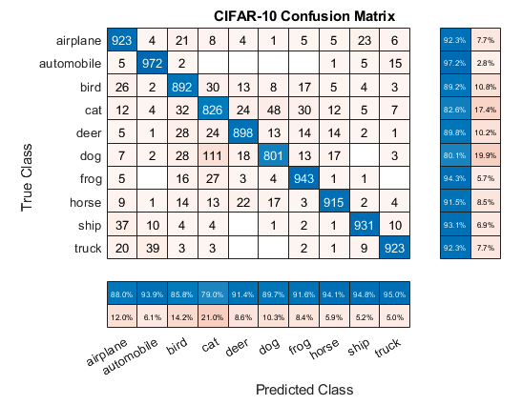
Confusion matrix
The confusion matrix is a great way to visualize where our model is making errors. Elements on the diagonal represent correct predictions. Elements off the diagonal represent that the model predicted the wrong class

